Slide 1
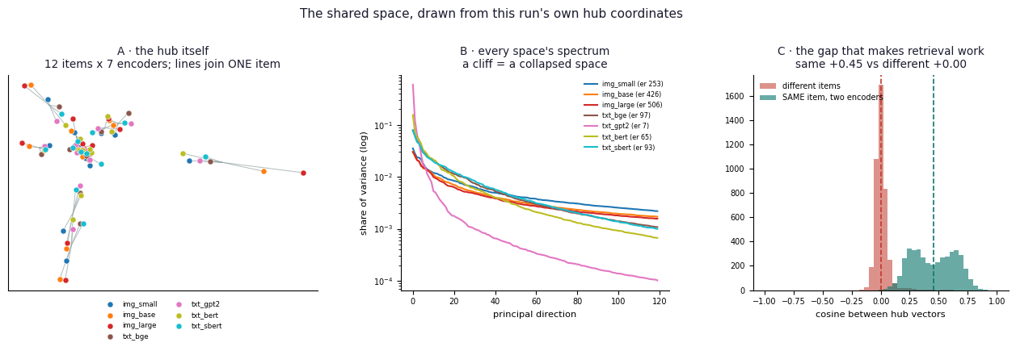
REPRESENTATION CONVERGENCE
Do Different Models
Discover the Same World?
From a deployable MobileCLIP-SigLIP adapter
to a seven-encoder shared Hub
20-minute project defense
Notes:
Open with the core question: models see different data and use different objectives, yet may learn related structures. The project turns that philosophical idea into a falsifiable engineering claim: a small linear map may translate between their coordinates.
[Sources]
- Results_Summary.pdf
- Final_Project_Report(5).pdf
- Huh et al. (2024), The Platonic Representation Hypothesis

Slide 2
The project began with a fascination for hidden regularity
In databases, correlation links named features. In vision and language, learned features are less visible - yet they still organize the world.
Nature
Learning
My lens
Fractals repeat structure across scales; the golden ratio appears in some growth patterns. These are examples of order, not proof of one universal law.
A network can begin with random weights and end by detecting a cat, or predicting the next word, because optimization extracts recurring statistical structure.
The project joins the material and the abstract: pixels, words, vectors and geometry become different views of one underlying system of relations.
02
Notes:
This is the edited English version of the Hebrew introduction. I was drawn to the contrast between explicit database features and latent neural features, and to the almost alchemical transition from random weights to useful structure. The scientific discipline is to replace wonder with testable claims. Claims such as 'an empire falls every 250 years' are not treated here as established laws; they illustrate the human search for patterns and the need for controls.
[Sources]
- User-provided Hebrew introduction
- Final_Project_Report(5).pdf, Sections 1-2

Slide 3
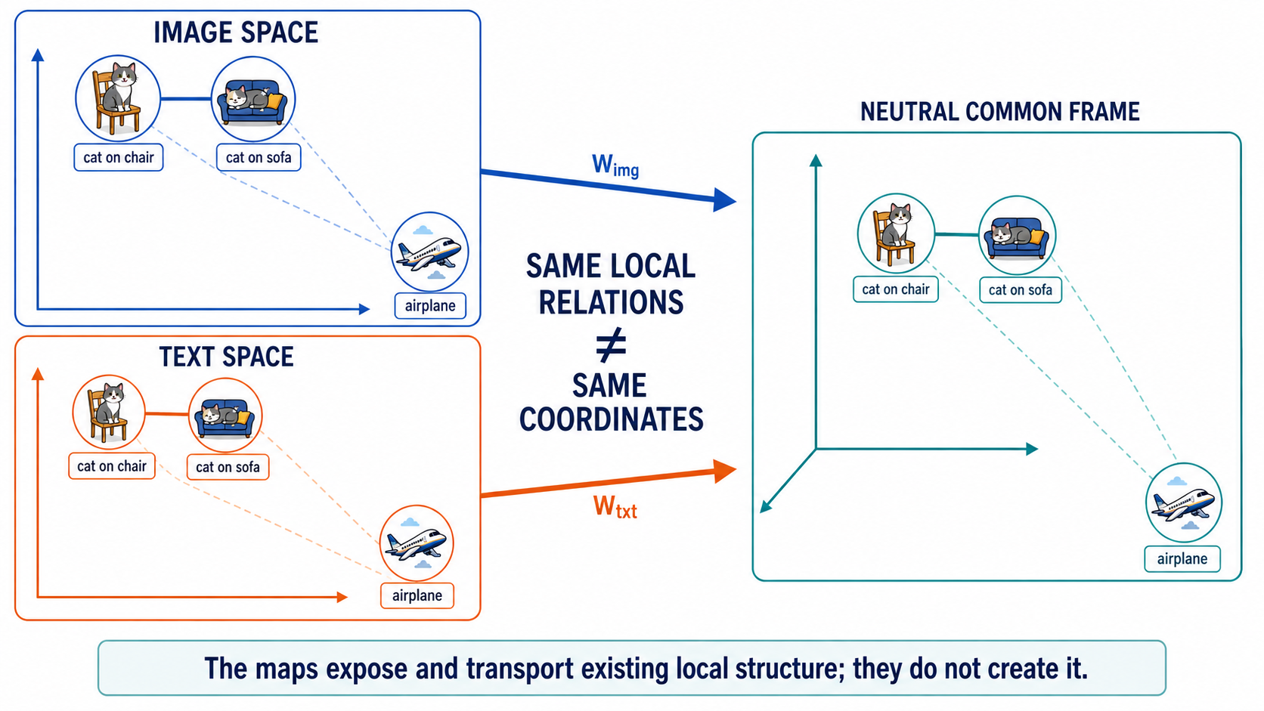
Notes:
The two native spaces use different axes and coordinates, so their raw vectors cannot be compared directly. Each space enters a genuinely neutral frame through its own learned map: W_img for image embeddings and W_txt for text embeddings. The local relation persists—cat-on-chair remains close to cat-on-sofa—but the long-range direction and distance to airplane change. This is the project's local-over-global result: the maps expose and transport existing local structure; they do not create it. We did not test the reverse pairwise text-to-image direction.
[Sources]
- Project_Atlas(1).pdf, Section 1
- Final_Project_Report(5).pdf, Appendix A
- Results_Summary.pdf, G5 and K1-K3
- Generated educational infographic based on the project's cat-chair / cat-sofa / airplane example

Slide 4
The philosophical question became four falsifiable tests
Scientific
Geometric
Do independently trained models share representations up to a linear transformation?
When similarity changes, is the cause modality, objective, lineage, anisotropy or rank?
Engineering
System
Can a tiny adapter make mobile and server encoders share one searchable index?
Can many encoders enter one frozen Hub so a component trained once transfers to unseen models?
04
Notes:
These questions separate scientific evidence from product value. A linear map is deliberately weak: if it succeeds on held-out data and beats controls, it reveals a pre-existing correspondence rather than learning an arbitrary task.
[Sources]
- Defense_Brief(2).pdf
- Final_Project_Report(5).pdf, Sections 2 and 5

Slide 5
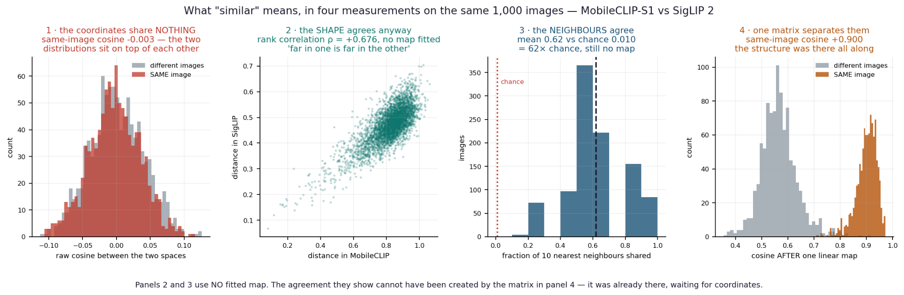
Similarity is not one number - geometry determines what each metric means
Isotropy
Anisotropy
Modality
Objective
variance spread evenly across directions
variance concentrated in a few directions
image, text or another sensory channel
the learning signal that shapes geometry
05
Notes:
We distinguished coordinate agreement, shape agreement, neighborhood agreement, functional transfer and semantic usefulness. A key lesson is that high cosine can be meaningless in a collapsed anisotropic space, while low raw coordinate agreement can hide a usable linear correspondence.
[Sources]
- Embedding_Spaces_Corrections_and_Figures.pdf
- Final_Project_Report(5).pdf, Section 2 and Appendices C.6-C.12
- similarity_explained.png

Slide 6
The study moved from pairwise proof to a reusable shared system
Track | Purpose | Models | Method | Headline result
A | Layer convergence | GPT-2, Pythia-160M | CKA + ridge stitching + random control | Peak held-out R² 0.797
B / F | Deployable adapter | MobileCLIP-S1, SigLIP 2 | Ridge, Procrustes, MLP, retrieval | 0.79 MB; R@5 95.3% of ceiling
E | Cross-modal geometry | DINOv2 S/B/L, bge, GPT-2, BERT, SBERT | Capacity sweep, whitening, controls | 40.9% → 58.3% of ceiling
G / K | Shared Hub | 7 members + SigLIP + ConvNeXt held out | Whitened PCA, entry maps, reusable head | 92.9-96.7% native transfer
C | Pair-free recovery | MobileCLIP-S1, SigLIP 2 | Gromov-Wasserstein | 39.7% exact; 595× chance
06
Notes:
This table is the project map. The two main systems in today's talk are B/F, the deployable two-model adapter, and G/K, the many-model Hub. The other tracks explain why those systems work and where their boundaries are.
[Sources]
- Results_Summary.pdf
- Project_Atlas(1).pdf

Slide 7
Experiment B maps phone images into the server search space
Phone photo
Linear adapter
Shared index
Text query
MobileCLIP-S1
512-d vector
W: 512 × 768
MatMul + normalize
SigLIP image space
768 dimensions
SigLIP text tower
nearest-neighbor search
3,000
1,000
0.79 MB
39 ms
paired training images
held-out images
fp16 Core ML artifact
demo upload-to-index
07
Notes:
Both encoders remain frozen. Ridge regression fits W in closed form from 3,000 paired image embeddings, and 1,000 images remain untouched for evaluation. At runtime, only the phone image vector is translated. Server text queries remain native SigLIP vectors.
[Sources]
- Final_Project_Report(5).pdf, Sections 4.1-4.6
- Vasu et al. (2024), MobileCLIP
- Tschannen et al. (2025), SigLIP 2

Slide 8
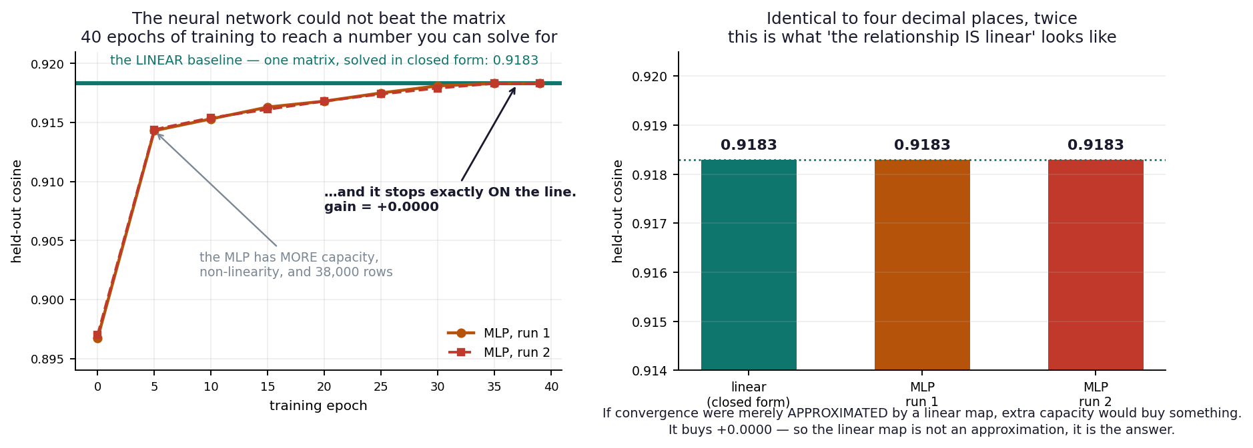
A nonlinear network could not improve the linear bridge
0.900
0.903
0.038
69×
ridge mean cosine
MLP mean cosine
Procrustes R²
singular-value spread
08
Notes:
The MLP had about 1.3 million parameters and optimized cosine loss for up to 300 epochs, yet gained only 0.003. On a fresh 38,000-row corpus it converged to exactly the linear result, 0.9183 to four decimals. Procrustes failed because the relation is not merely a rotation: scaling and anisotropy matter.
[Sources]
- Results_Summary.pdf, Experiment B and Series F
- Final_Project_Report(5).pdf, Sections 4.3-4.4
- mlp_vs_linear.png

Slide 9
The adapter is both a scientific instrument and a deployable component
Live qualitative demo
• Free-text query retrieved phone-indexed images in the same result list as server images.
• 'striped animals' retrieved zebra without keyword matching.
• Absent query 'a dog' produced a correctly flat similarity profile.
• fp16 was ranking-neutral; optional top-10 server re-ranking recovers R@1-critical cases.
Verification AUC 0.999 | ranking R@1 0.987
09
Notes:
The operational result is 88.4% of native at R@1, 95.3% at R@5 and 97.2% at R@10. The project chose to ship the linear map because the nonlinear alternative added complexity without value. The live demo showed compositional retrieval, negative controls and fp16 parity.
[Sources]
- Results_Summary.pdf, Experiment B
- Final_Project_Report(5).pdf, Sections 4.5-4.6

Slide 10
The Hub replaces pairwise bridges with one shared coordinate system
Build once
• Standardize seven aligned encoder spaces independently.
• Concatenate 8,533 training rows across all members.
• SVD/PCA keeps 512 shared directions; whitening equalizes retained variance.
Enter independently
• Fit one ridge entry map XₖWₖ ≈ H per encoder.
• Freeze the Hub and the reusable caption head.
• Add unseen encoders with a new entry map only.
10
Notes:
The Hub is not DINOv2-small. It is a single 512-dimensional PCA coordinate system built jointly from seven standardized spaces. DINOv2-small supplies the training route for one caption head, but every encoder receives an independent map into the frozen Hub.
[Sources]
- Results_Summary.pdf, Series G
- Final_Project_Report(5).pdf, Appendix C.13
- hub_full_flow_diagram.png

Slide 11
A head trained once transfers to unseen models and architectures
What changed?
• DINOv2-B/L: unseen capacity within one family
• SigLIP 2: independent lineage and objective
• ConvNeXt: convolutional architecture, supervised training
The transfer survived lineage and architecture.
Objective remains a confound, not a solved boundary.
11
Notes:
The reproduced G0 protocol returned the published SigLIP 94.2% to the decimal. ConvNeXt-base reached 96.7%, above the within-family band. Therefore shared ancestry and transformer architecture do not explain the transfer. But no result yet simultaneously changes architecture, modality and objective.
[Sources]
- Results_Summary.pdf, G0 and G4-conv addenda
- Final_Project_Report(5).pdf, C.13.2 and Appendix E.2

Slide 12
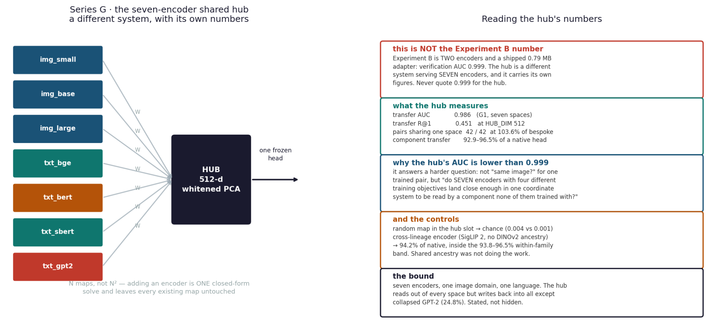
Seven encoders enter one Hub without reducing transfer
0.451
0.986
95.6%
+0.006
R@1 at Hub width 512
verification AUC
retention over 36/41 pairs
vs five-space Hub
12
Notes:
Adding BERT and Sentence-BERT left transfer statistically unchanged: 0.451 versus 0.445. This is the useful result - the shared space absorbed new objectives without harming existing components. Five weak cases all wrote into GPT-2's collapsed geometry; reading out of GPT-2 remained strong.
[Sources]
- Results_Summary.pdf, G1 extended and G10
- auc_hub_seven.png

Slide 13
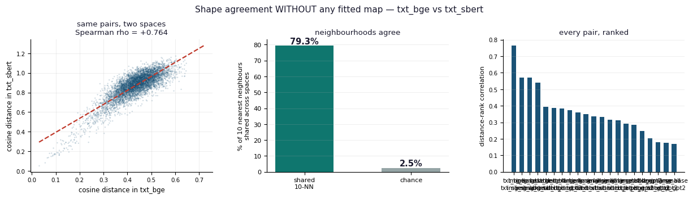
Objective and geometry explain more than modality alone
Objective
Lineage
Modality
Locality
+53×
+44×
+29×
21/21
strongest exploratory grouping effect
important, but not sufficient
cross-modal agreement is weaker
pairs agree more locally than globally
13
Notes:
Before fitting any map, bge-SBERT showed the strongest shape agreement despite sharing no lineage - they share a contrastive objective. Exploratory grouping ranked objective above lineage above modality. This is not causal proof, because factors remain confounded. CKNNA and permutation-calibrated CKA supported the local-over-global conclusion.
[Sources]
- Results_Summary.pdf, G5, K1-K3
- shape agreement.png

Slide 14
Two geometric lessons changed the interpretation of failure
Isotropy rescue
Near-null width cliff
GPT-2 target retrieval
At source ambient dimension
R@1 0.130 → 0.478
σ: 10.79 → 0.0054
• effective rank: 6.5 → 490.8
• 102.6% of contrastive bge arm
• isotropy helps read a correspondence
• least squares amplifies one weak direction
• 6/6 curves hit 768, 1536 or 2048
• truncation or head alpha repairs it
A failure can belong to the coordinate frame or the numerical solver - not to the shared representation.
14
Notes:
Whitening rescued GPT-2 retrieval because cosine needs an isotropic space. Yet whitening destroyed Gromov-Wasserstein matching, because uneven variance made points distinctive. Separately, the Hub width cliff was traced to one near-null singular direction exactly when width reached source rank. It was a numerical artifact, not evidence against shared structure.
[Sources]
- Results_Summary.pdf, E1.2, C.12, G9-G16
- Status_Report(2).pdf

Slide 15
Recent experiments: goals, methods, outcomes and honest boundaries
ID | Goal | Models / training | Method | Outcome
B/F | Can a mobile encoder join a server index? | MobileCLIP distilled contrastively; SigLIP 2 sigmoid contrastive | Ridge vs Procrustes vs MLP | Linear ships; MLP adds 0.0000 at scale
E1 | Does cross-modal alignment scale? | DINOv2 self-supervised; bge contrastive text | Frozen embeddings + ridge + matched ceilings | 40.9 → 58.3% across S/B/L
G1/G3 | Can seven spaces share one system? | 3 vision + 4 text objectives | Whitened PCA Hub + 42 ordered pairs | 42/42 shared; mean 103.6% of bespoke
G4 | Does transfer cross lineage/architecture? | SigLIP 2; ConvNeXt IN-22k supervised | Frozen Hub + new entry map | 94.2% and 96.7% of native
G10 | Does Hub composition matter? | bge/BERT membership ablations | Fixed count and target-overlap controls | Text identity moves transfer 6.1 pts
G14-16 | What caused the width cliff? | DINOv2 S/B/L source ranks | Fine width scan, SVD, truncation, alpha | Near-null direction confirmed; repaired
15
Notes:
This table emphasizes the most recent experiments. It also distinguishes how the models were trained: DINOv2 is self-supervised on images; MobileCLIP is distilled from contrastive teachers; SigLIP uses a sigmoid image-text objective; bge and SBERT are similarity-oriented text encoders; GPT-2 is next-token prediction; BERT is masked-language modeling; ConvNeXt is supervised here on ImageNet-22K.
[Sources]
- Results_Summary.pdf, 23-24 August 2026 addenda
- Project_Atlas(1).pdf
- Final_Project_Report(5).pdf

Slide 16
The failures became safeguards - and strengthened the claims
Failure caught | What it could have falsely implied | Safeguard added
Sample starvation in Run 1 | Weak convergence | Rows-per-dimension floor and power gate
Synthetic hot diagonal | Layer-specific structure | Real matrix, marginals, lift and hubness diagnostics
Mismatched retrieval ceiling | Inflated cross-modal performance | Treatment-matched ceiling in every run
Wrong teacher checkpoint | False distillation comparison | Teacher-tagged artifacts and transfer checks
Premature gate-passed claim | Overstated deployment quality | Paired bootstrap on expanded galleries
Rank/cliff false negative | Rejected numerical explanation | Algebraic-rank test and head-fit ablation
Reproducibility is part of the innovation: frozen caches, deterministic splits, shuffle controls and 47 artifact checks.
16
Notes:
The project records its own errors rather than hiding them. Each error generated a reusable engineering guard. That makes the final claims narrower, but more defensible.
[Sources]
- Results_Summary.pdf, Series H/V and G13
- Status_Report(2).pdf

Slide 17
What has been established - and what should be tested next
Established
Next experiments
• Linear correspondence is measurable across language, vision and cross-modal pairs.
• A 0.79 MB adapter supports a real shared-index product path.
• A frozen Hub transfers a reusable head to unseen lineage and architecture.
• Geometry - isotropy, anisotropy and rank - controls which similarity metrics are trustworthy.
• Simultaneously change modality, objective and architecture.
• Run pair-free recovery where no similarity objective is shared.
• Test wider mobile encoders to locate the information ceiling.
• Expand beyond COCO and beyond the current 9,533 aligned items.
• Validate causal effects of objective with better-controlled model pairs.
• Turn the Hub demo into bidirectional text→image and image→text retrieval.
The strongest conclusion is constructive: different models can share useful structure without sharing coordinates.
Key literature: Kornblith 2019 · Bansal 2021 · Huh 2024 · MobileCLIP 2024 · SigLIP 2 2025 · vec2vec 2025
17
Notes:
Close by returning to the opening wonder. The project does not prove one universal representation. It establishes a bounded, constructive result: across the tested models and data, useful structure survives a simple linear change of coordinates. The next step is to break the remaining confounds, not to broaden the claim beyond the evidence.
[Sources]
- Results_Summary.pdf
- Final_Project_Report(5).pdf, References
- Kornblith et al. (2019)
- Bansal et al. (2021)
- Huh et al. (2024)
- Vasu et al. (2024)
- Tschannen et al. (2025)
- Jha et al. (2025)

Slide 18
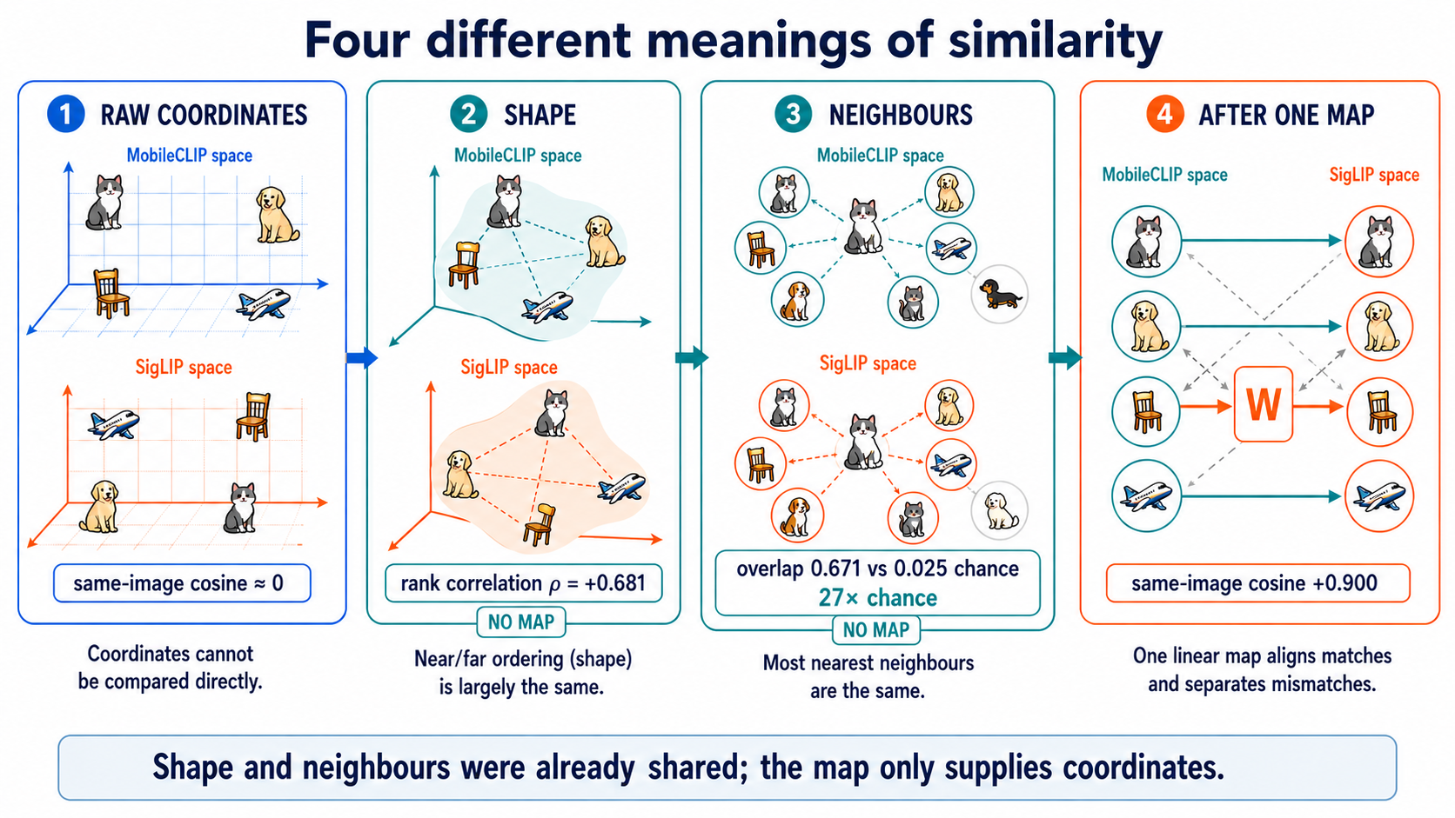
Notes:
Optional explainer. Start with the same cat represented by MobileCLIP and SigLIP. Raw cosine is near zero because the axes are unrelated. Then ignore coordinates and compare distance ordering: shape agrees at rho 0.681 without a map. Neighborhood overlap is 0.671 versus chance 0.025, a 27-times lift, also without a map. Only the fourth panel fits W, raising same-image cosine to 0.900. Therefore W reveals and coordinates structure already detected by panels two and three; it did not create that structure.
[Sources]
- User-provided MobileCLIP-S1 vs SigLIP 2 four-measurement figure
- Final_Project_Report(5).pdf, p. 34
- Results_Summary.pdf, Experiment B and geometry controls
- Generated educational infographic

Slide 19

Notes:
Optional explainer. Shape agreement does not compare the cat's coordinates across encoders. It asks whether statements such as 'cat is nearer to dog than to airplane' remain true. The image and text layouts may be rotated, stretched or otherwise globally different. The measured group means were 0.56 for image-image, 0.29 for image-text and 0.40 for text-text. The strongest pair, bge-SBERT at 0.76, shows that a shared similarity-oriented objective can outweigh shared modality or lineage.
[Sources]
- User-provided shape-agreement summary figure
- Results_Summary.pdf, G5 and K1-K3
- Generated educational infographic

Slide 20
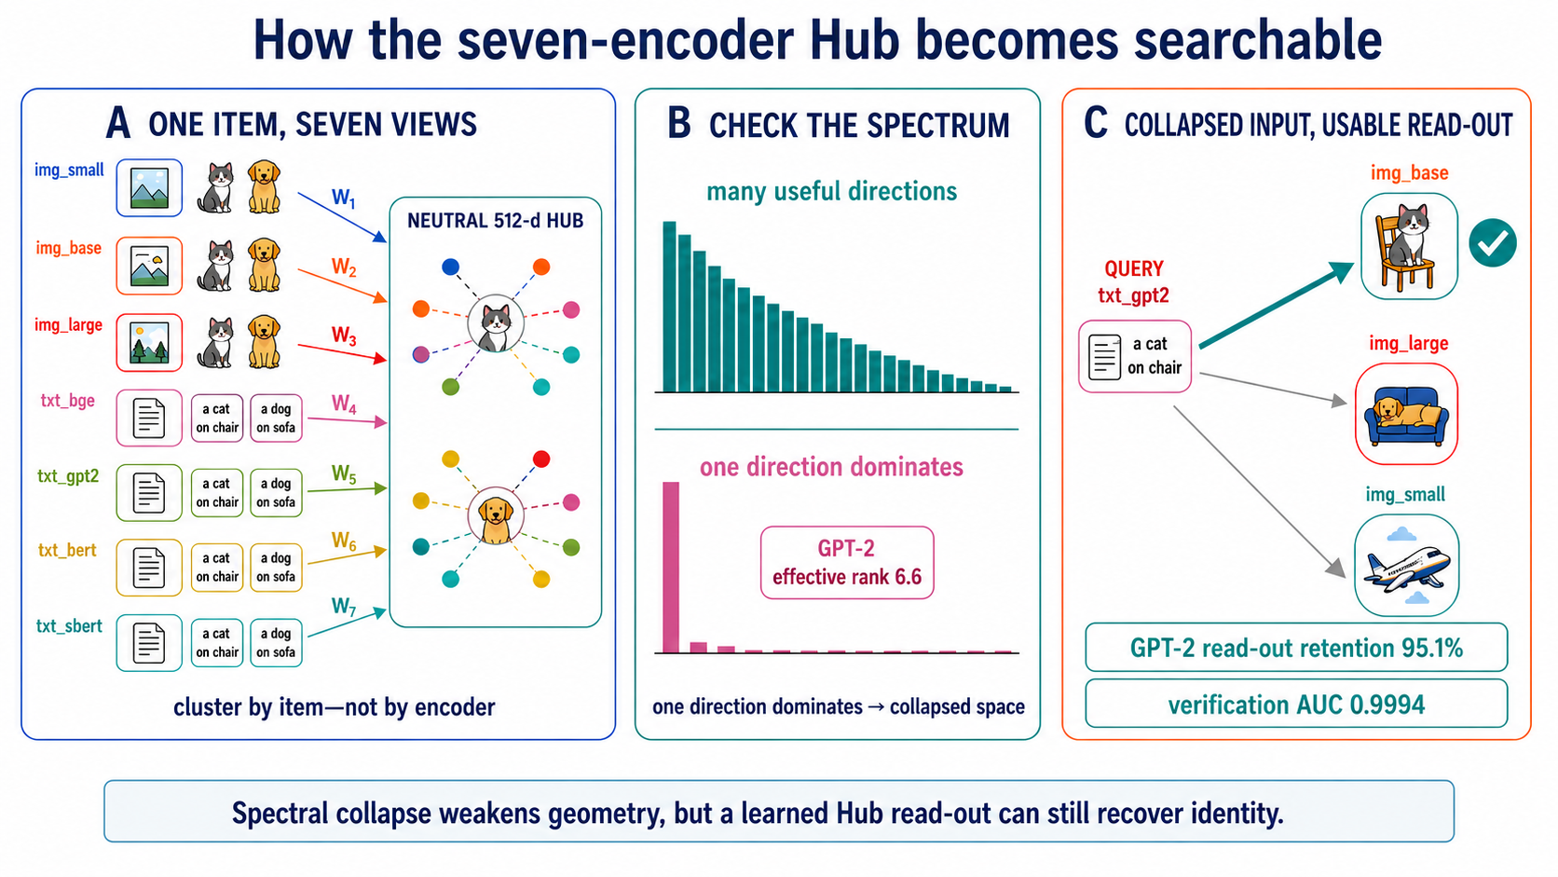
Notes:
Optional explainer. Each of the seven encoders receives an independent entry map W_k into the neutral 512-dimensional Hub. Corresponding versions of one item should cluster by identity rather than by encoder. The singular spectrum checks whether the representation uses many useful directions or collapses into one dominant direction. GPT-2 is the collapsed case here, with effective rank 6.6. This is spectral collapse, not the separate width-cliff numerical artifact. Despite the collapse, the learned Hub read-out retains 95.1% and verification reaches AUC 0.9994, showing that identity can remain recoverable after a learned entry map.
[Sources]
- User-provided Hub coordinates, spectrum and retrieval figure
- Results_Summary.pdf, Series G and G13
- Technical cheat sheet and corrections document
- Generated educational infographic

Slide 21
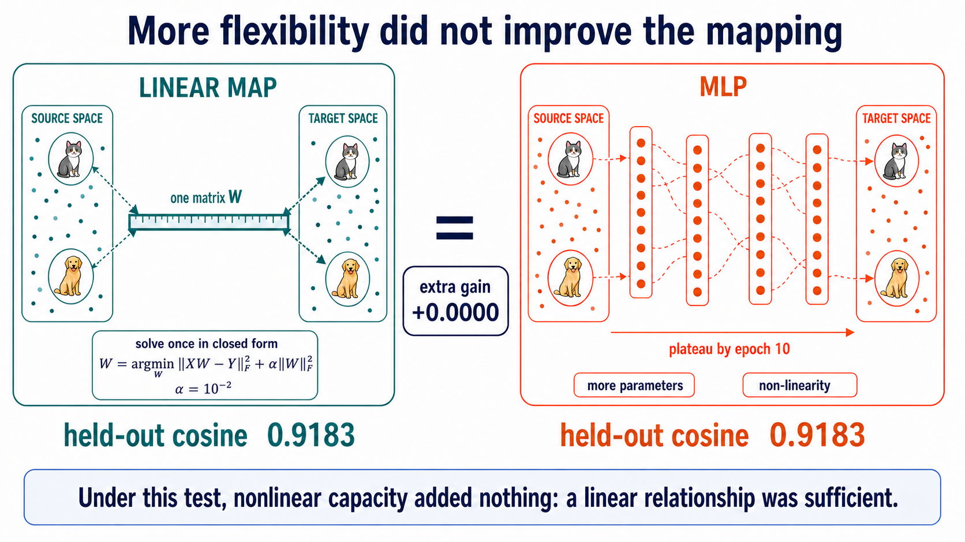
Notes:
Optional explainer. Both routes receive the same source embeddings and must recover the same target identities. The linear route solves ridge regression in closed form: minimize squared error plus alpha times the squared Frobenius norm of W, with alpha 10^-2. The MLP has greater capacity and non-linearity but plateaus by epoch 10. Both reach held-out cosine 0.9183, for a gain of +0.0000. The defensible conclusion is bounded: under this dataset, objective and optimization, nonlinear capacity did not improve the mapping; this supports linear sufficiency here, not universal exact linearity.
[Sources]
- User-provided MLP-versus-linear figure
- Results_Summary.pdf, Experiment B and Series F
- Final_Project_Report(5).pdf, E.8-E.9
- Generated educational infographic

